Slide 1
Confusion Matrix and Comparing Classification Methods
Clarifying False Positives and False Negatives

Slide 2
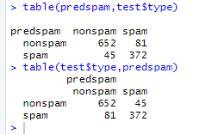
Take note where your predictions are depends on your order.
We have been mainly using this order.
Predictions over here
In either case, the table predicted 81 as nonspam that were spam, and we predicted 45 spam that were actually nonspam.

Slide 3
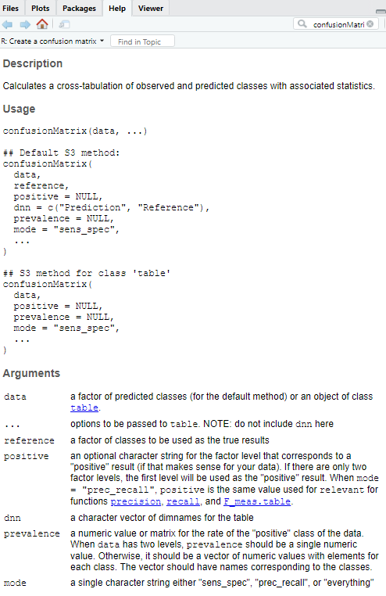
Table Compared to Confusion Matrix
Right order without specifying argument names:
confusionMatrix(knnclass, test$diabetes)
Or --- confusionMatrix(data=knnclass, reference=test$diabetes)
Incorrect order without specifying argument names:
confusionMatrix(test$diabetes,knnclass)

Slide 4
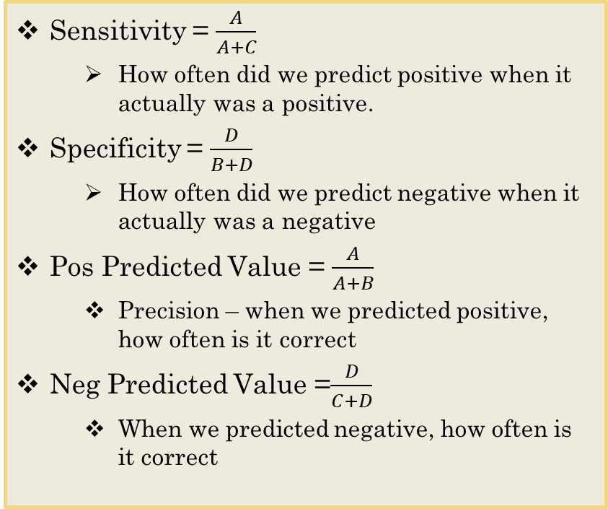
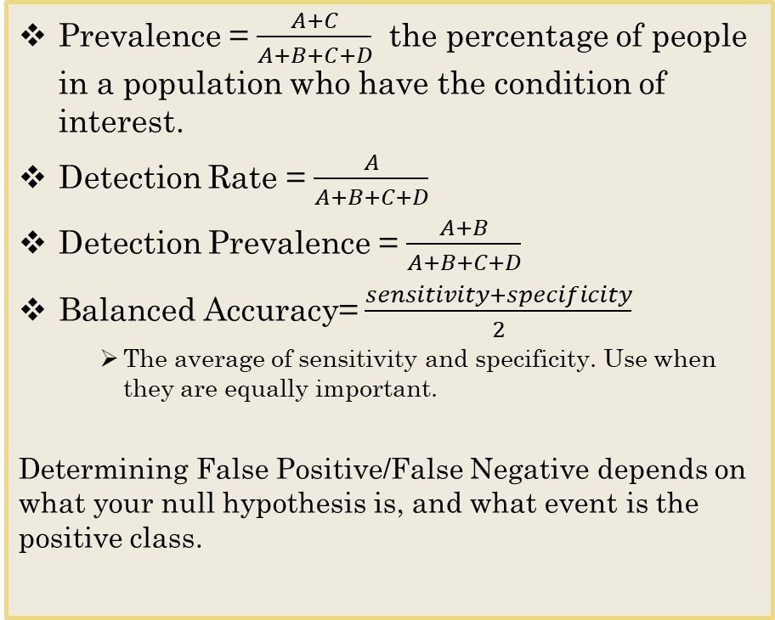
Confusion Matrix
 | Reference
Predicted | Event | No Event
Event | A - True Positive | B – False Positive (Type 1 Error)
No Event | C - False Negative (Type 2 Error) | D - True Negative
Prevalence = $\frac{A+C}{A+B+C+D}$ the percentage of people in a population who have the condition of interest.
Detection Rate = $\frac{A}{A+B+C+D}$
Detection Prevalence = $\frac{A+B}{A+B+C+D}$
Balanced Accuracy= $\frac{sensitivity+specificity}{2}$
The average of sensitivity and specificity. Use when they are equally important.
Determining False Positive/False Negative depends on what your null hypothesis is, and what event is the positive class.
Sensitivity = $\frac{A}{A+C}$
How often did we predict positive when it actually was a positive.
Specificity = $\frac{D}{B+D}$
How often did we predict negative when it actually was a negative
Pos Predicted Value = $\frac{A}{A+B}$
Precision – when we predicted positive, how often is it correct
Neg Predicted Value =$\frac{D}{C+D}$
When we predicted negative, how often is it correct

Slide 5
A Comparison of Classification Methods
Logistic regression and LDA are closely related (linear decision boundaries), so one might expect the two approaches to give similar results. --- This is often, but not always, the case.
LDA assumes that the observations are drawn from a Normal distribution with a common covariance matrix in each class, and so can provide some improvements over logistic regression when this assumption approximately holds.
Conversely, logistic regression can outperform LDA if these Normal and covariance assumptions are not met.

Slide 6
Comparing LDA and QDA
LDA and QDA have similarities, and it is important to distinguish between them.
The model on the left is both an LDA and QDA with normal Gaussian distribution that have a common correlation of 0.7 between X1 and X2.
As a result, the Bayes decision boundary is linear and is accurately approximated by the LDA decision boundary.
The QDA decision boundary is inferior, because it suffers from higher variance without a corresponding decrease in bias.
In contrast, the model on the right displays a situation in which the orange class has a correlation of 0.7 between the variables and the blue class has a correlation of −0.7.
Now the Bayes decision boundary is quadratic, and so QDA more accurately approximates this boundary than does LDA.

Slide 7
A Comparison of Classification Methods
In contrast, KNN is a completely non-parametric approach: no assumptions are made about the shape of the decision boundary. Therefore, we can expect this approach to dominate LDA and logistic regression when the decision boundary is highly non-linear.
KNN does not tell us which predictors are important
We don’t get a table of coefficients with significance measures, for example.
Also, as we observed when discussing KNN, it is very unreliable in high dimensions.

Slide 8
QDA vs. KNN
QDA serves as a compromise between the non-parametric KNN method and the linear LDA and logistic regression approaches.
Since QDA assumes a quadratic decision boundary, it can accurately model a wider range of problems than can the linear methods.
Though not as flexible as KNN, QDA can perform better in the presence of a limited number of training observations because it does make some assumptions about the form of the decision boundary.

Slide 9
Scenario Examples
To illustrate the relative performance of these four classification approaches, consider data from six different scenarios:
In three of the scenarios, the Bayes decision boundary is linear, and in the remaining three scenarios it is non-linear.
For each scenario, 100 random training data sets were produced. On each of these training sets, each method was fit to the data and the resulting test error rates were computed on a large test set.
The KNN method requires selection of K, the number of neighbors. We consider KNN with two values of K: K = 1, and a value of K that was chosen automatically using an approach called cross-validation (we will discuss this technique as our next major topic).
In each of the six scenarios, there were p = 2 predictors.

Slide 10
Scenario 1
There were 20 training observations in each of the two classes.
The observations within each class were uncorrelated random normal variables with a different mean in each class.
The left-hand panel above shows that LDA performed well in this setting, as one would expect since this is the model assumed by LDA.
KNN performed poorly because it paid a price in terms of variance that was not offset by a reduction in bias.
QDA also performed worse than LDA, since it fit a more flexible classifier than necessary.
Since logistic regression assumes a linear decision boundary, its results were only slightly inferior to those of LDA.

Slide 11
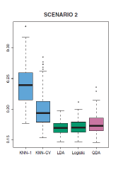
Scenario 2
Details are as in Scenario 1, except that within each class, the two predictors had a correlation of −0.5.
The center panel above indicates little change in the relative performances of the methods as compared to the previous scenario.

Slide 12
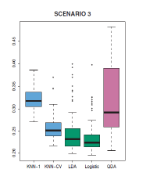
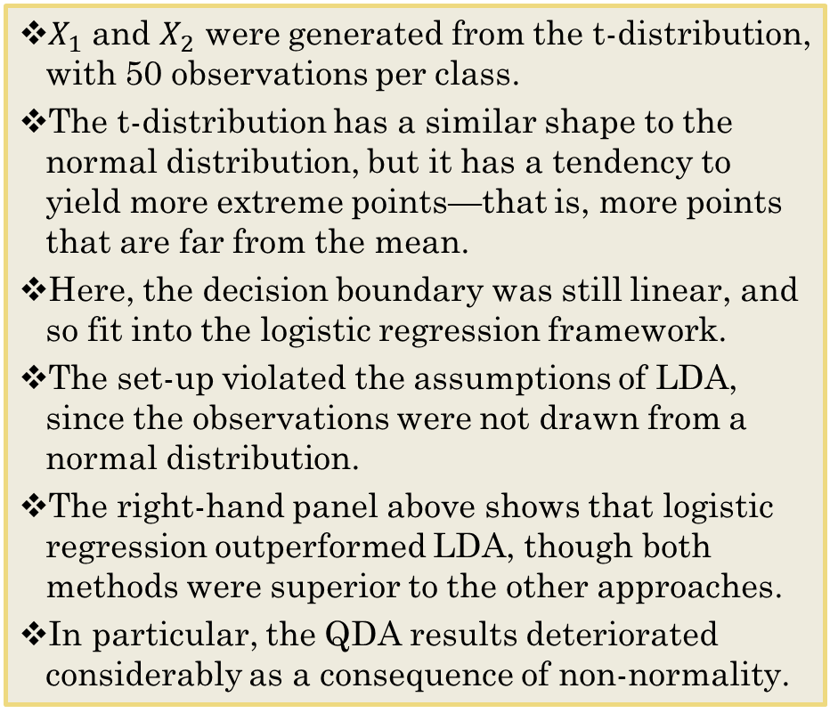
Scenario 3
$X_{1}$ and $X_{2}$ were generated from the t-distribution, with 50 observations per class.
The t-distribution has a similar shape to the normal distribution, but it has a tendency to yield more extreme points—that is, more points that are far from the mean.
Here, the decision boundary was still linear, and so fit into the logistic regression framework.
The set-up violated the assumptions of LDA, since the observations were not drawn from a normal distribution.
The right-hand panel above shows that logistic regression outperformed LDA, though both methods were superior to the other approaches.
In particular, the QDA results deteriorated considerably as a consequence of non-normality.

Slide 13
Scenario 4
The data were generated from a normal distribution, with a correlation of 0.5 between the predictors in the first class, and correlation of −0.5 between the predictors in the second class.
This setup corresponded to the QDA assumption, and resulted in quadratic decision boundaries.
The left-hand panel shows that QDA outperformed all of the other approaches

Slide 14
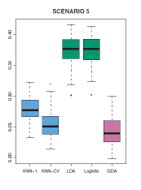
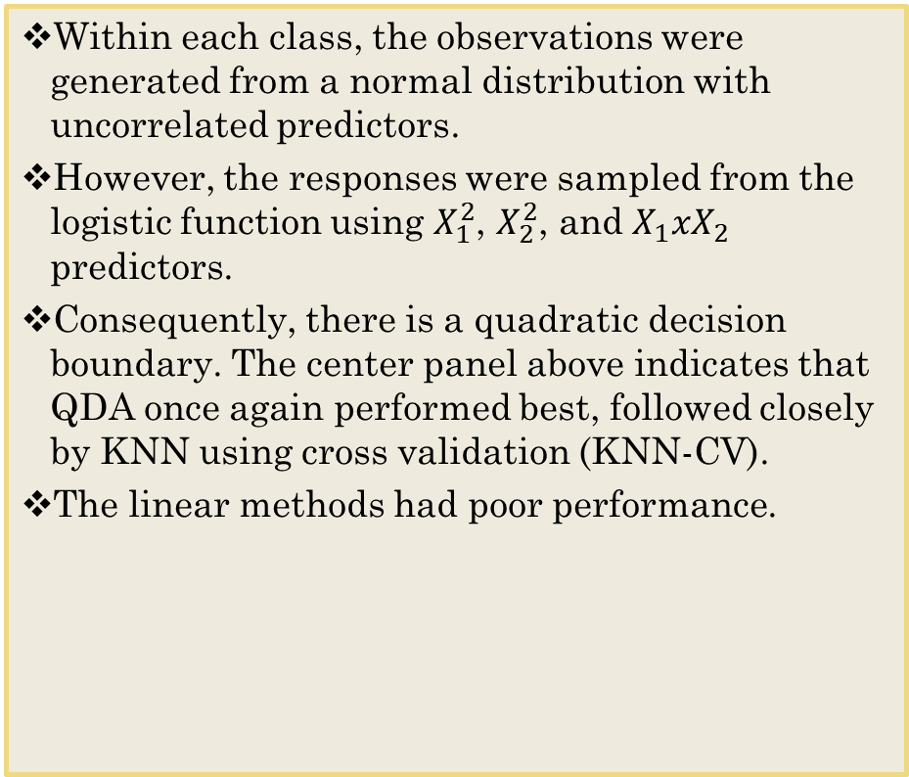
Scenario 5
Within each class, the observations were generated from a normal distribution with uncorrelated predictors.
However, the responses were sampled from the logistic function using $X_{1}^{2}$, $X_{2}^{2}$, and $X_{1}xX_{2}$ predictors.
Consequently, there is a quadratic decision boundary. The center panel above indicates that QDA once again performed best, followed closely by KNN using cross validation (KNN-CV).
The linear methods had poor performance.
Notes:
The linear functions do worse because the predictors are uncorrelated (non-linear)

Slide 15
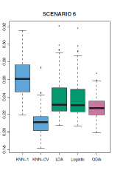
Scenario 6
Details are as in the previous scenario, but the responses were sampled from a more complicated non-linear function.
As a result, even the quadratic decision boundaries of QDA could not adequately model the data.
The right-hand panel above shows that QDA gave slightly better results than the linear methods, while the much more flexible KNN-CV method gave the best results.
But KNN with K = 1 gave the worst results out of all methods. This highlights the fact that even when the data exhibits a complex nonlinear relationship, a non-parametric method such as KNN can still give poor results if the level of smoothness is not chosen correctly.

Slide 16
To Do
Work on Case 4!

